Slide 1
WACO DISTRICT

Slide 2
Safety Share – Waco District
Mark Davis

Slide 3
Waco District
Initiatives
Update on Emulsion Treatment
BMD Projects
Challenges and Issues
Gradation Consistency
Correction Factors
Trucking / Paver Continuous Operations
Timeliness of request for referee
May 1, 2025

Slide 4
Waco District
2026
SP C 70-22 - 43,923 tons
DGR B 64-22 – 63,222 tons
SMA D 76-22 SAC A – 39,078 tons
DGR D 64-22 Level-up – 12,483 tons
SP B 64-22 - 46.486 tons
DGR C 64-22 – 9.896 tons
Total = 215,088
May 1, 2025

Slide 5
Waco District
2027
SP C 70-22 - 84,668 tons
DGR B 64-22 – 9,915 tons
SMA D 76-22 SAC A – 0 tons
DGR D 64-22 Level-up – 0 tons
SP B 64-22 - 0 tons
DGR C 64-22 – 0 tons
Total = 309,672 tons
May 1, 2025

Slide 6
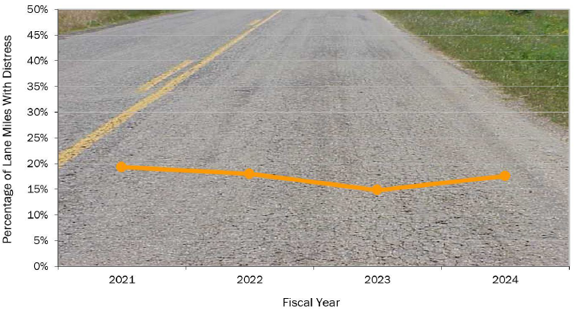
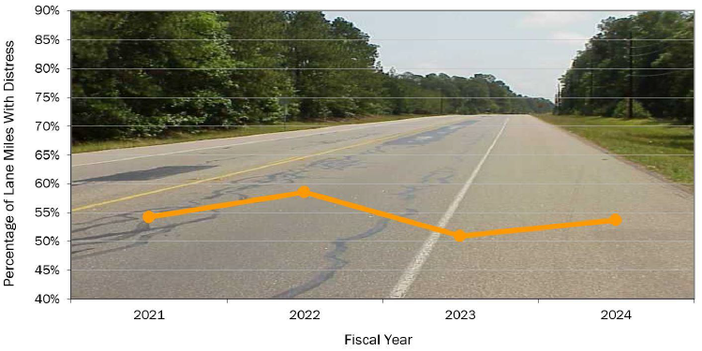
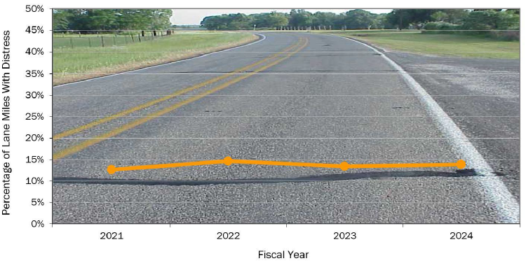
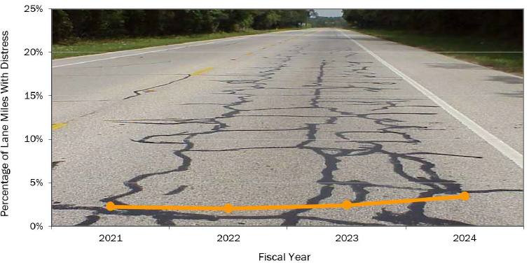
Statewide Trends (Cracking)
Provided by MNT Division
Alligator Cracking
Longitudinal Cracking
ACP Transverse Cracking
ACP Block Cracking

Slide 7
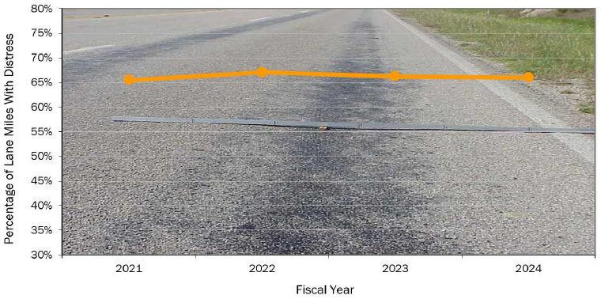
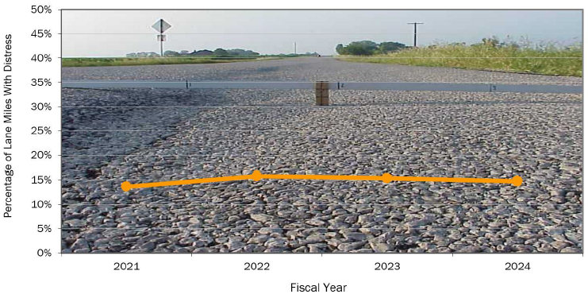
Statewide Trends (Rutting)
Provided by MNT Division
Shallow Rutting
Deep Rutting

Slide 8
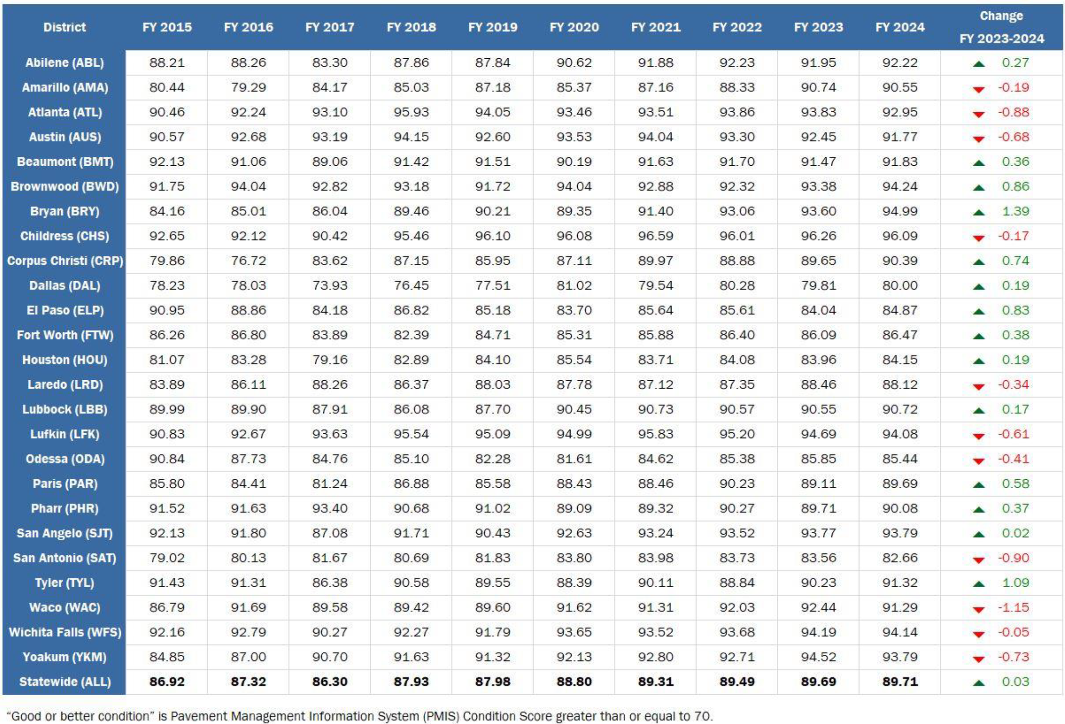
Status of Statewide Pavement Condition
Provided by MNT Division
91.29

Slide 10
MTD Updates
Flexible Pavements Section
Asphalt Binder Section
Soils and Aggregates Section
May 1, 2025

Slide 11
Flexible Pavements Section
Travis Patton, PE
Section Director
Travis.Patton@txdot.gov
512-221-7408
Melissa Benavides, PE
Operations
Melissa.Benavides@txdot.gov
512-506-5976
Samuel Mendoza, EIT
Laboratory/Technical Support
Samuel.Mendoza1@txdot.gov
512-506-5805
Benjamin Arras, EIT, PhD
Laboratory/Technical Support
Benjamin.Arras@txdot.gov
512-884-7256
Sydnie Thibodeaux
Technical Support
Sydnie.Thibodeaux@txdot.gov
737-351-7960
General Inquiries: MTD-Flexpave-Engineering@txdot.gov

Slide 12
Asphalt Binder Section
Pravat Karki, PE, PhD
Section Director
Pravat.Karki@txdot.gov
512-865-9457
Ali Arabzadeh, PE, PhD
Operations
Ali.Arabzadeh@txdot.gov
512-506-5804
Eloy Lopez Minjares
Operations
Eloy.LopezMinjares@txdot.gov
512-506-5945
Zahra SotoodehNia, PE, PhD
ABQP
Zahra.SotoodehNia@txdot.gov
512-506-5803
Ismael Morales, EIT
ABQP
Ismael.Morales@txdot.gov
512-671-0939
Sampling Inquiries: Jasmine.Ryan@txdot.gov
General Inquiries: MTD-Asphalt-Engineering@txdot.gov

Slide 13
Soils and Aggregates Section
Gisel Carrasco, PE
Section Director
gisel.carrasco@txdot.gov
512-354-5768
Sandeep Pandey, PE
Technical/QA Operations Lead
sandeep.pandey@txdot.gov
512-902-3746
Michael Dawidczik, PG
Soils Lab/Certification Lead
michael.dawidczik@txdot.gov
512-944-4263
Victor Vogt, PE
Aggregates Lab Lead
victor.vogt@txdot.gov
512-902-7706
Edward Morgan, PG
Petrography Lab Lead
edward.morgan@txdot.gov
512-853-0774
General Inquires: mtd-sa@txdot.gov

Slide 14
Organization Chart – Pavement Section
James Stevenson, PE
Chris Henry, PE
Division Director
james.stevenson@txdot.gov
(512) 284-1689
Deputy Division Director
chris.henry@txdot.gov
(940) 447-5093
Jenny Li, PE
Section Director
jenny.li@txdot.gov
(512) 745-2717
PMIS
PAV Design/Forensics
Hui Wu, PE
Ruben Carrasco, PE
PAV Preservation Branch Mgr.
hui.wu@txdot.gov
(512) 415-4375
PAV Design Branch Mgr.
ruben.carrasco@txdot.gov
(512) 364-8353

Slide 15
Tools and Resources

Slide 19
Asphalt Pavement Exchange
APEX Working Groups
Essentials Workshop (Greg Cedillo and Eric Suarez)
Mixture Type and Design (Ryan Barborak and Alex Flores)
Construction (Lacy Peters and Jason Exum)
Safety (Robert Godina and Darren Poe)
Asphalt Pavement Specialist (Duane Milligan and Chad Bohne)
Ride Quality (Daniel Garcia and Josh Houston)
Pavement Design (James Stevenson and Magdy Mikhail)
Communication (Mike Walsh & Kal Kincaid)
PROGRAM GOAL:
Develop and implement a dedicated, coordinated, and continuously improved asphalt pavement knowledge-sharing education program for TxDOT, Industry, and Consultants to deliver quality HMACP.
Chris Cowen (TxDOT) & Cliff Kay (AL Helmcamp)

Slide 21
WACO DISTRICT

